Slide 1
Coding Basics and Importing Data
Patrick Mathias
DLMP Core

Slide 2
Lesson Goals
Compare and contrast different data types (e.g., numerical, categorical, timestamp, logical) used in data analytics
Conduct basic exploratory data analysis to evaluate data quality or assumptions and summarize using quantitative, qualitative, univariate, and multivariate methods
Lesson Objectives
Use a function to perform an operation on data
Define and create objects in the environment
Install and load packages
Import data from a file into the R environment
Inspect the contents of a dataframe
Notes:
In the second session we will learn some fundamentals of coding including using functions, creating objects, and importing data.

Slide 3
The Basics of Coding

Slide 4
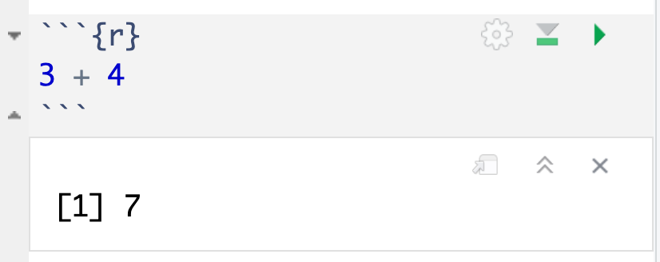
The Basics of Coding: Calculation
press play button to execute code
R is a calculator!
answer returned below
Notes:
At it’s most basic, R is a fancy calculator.
It supports common mathematical operators
+ add, - subtract
* multiply, / divide
^ exponents
When we execute our code by pressing the play button, the answer is returned below the code chunk.

Slide 5
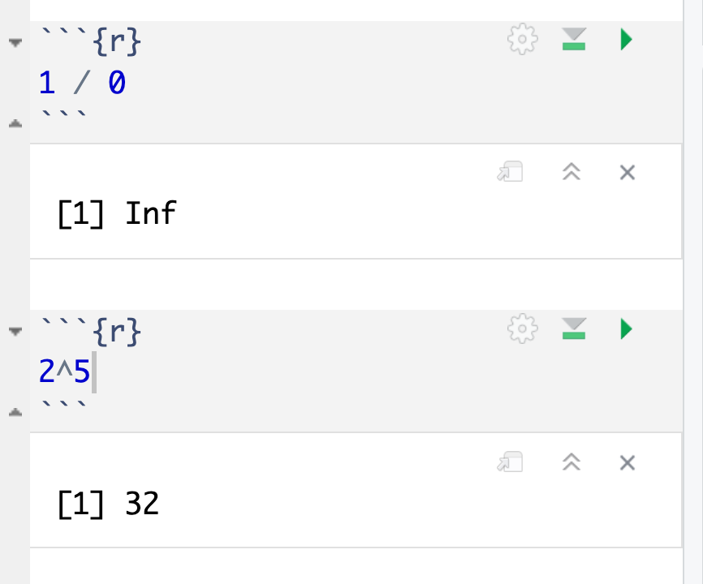
Common arithmetic operations

Slide 6
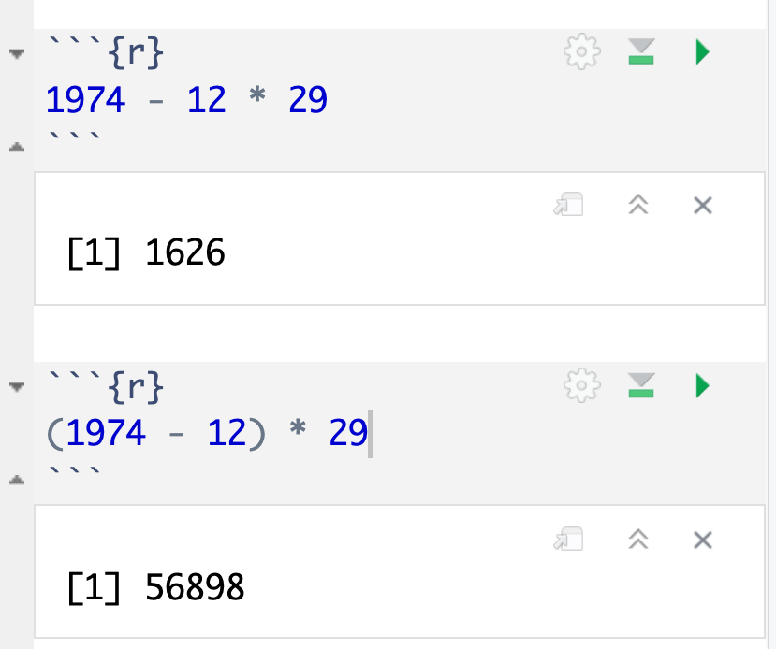
Don’t forget those math rules

Slide 7
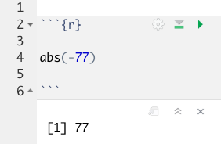
The Basics of Coding: Functions
Code that extends our reach beyond the basic operators
function
(does stuff)
argument
(input)
abs(-77 )
Notes:
Functions are code that perform actions on our behalf. We can use functions that others have written (or that we write ourselves) to reuse existing code over and over.
Functions accept an argument (input). We use parentheses as the syntax (grammar) to identify the argument(s).
Then the function does its task and provides us with some output, in this case the absolute value of an integer.

Slide 8
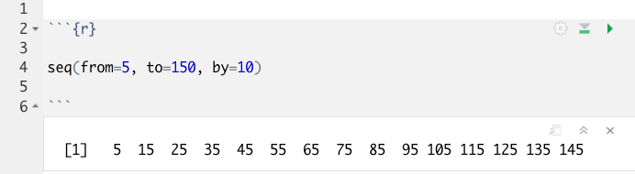
Putting Functions to Work
We can use functions to do more than simple math, we can make things!
We can create a series of integers (a vector) using the seq() function
Notes:
Functions can do more than simple math.
In this case the sequence function seq() accepts arguments defining a start position, a stop position, and an interval, to create a series (a vector) of integers.

Slide 9
The Basics of Coding: Objects
Objects are the container for your output
object
(stores output)
function
(does stuff)
arguments
(input)
sequence_of_10s <- seq(from=5, to=150, by=10 )
Notes:
Objects are a very important concept in many programming language.
Objects are the containers in which we can store things for later use.
You can store single values, series, tables, or even text.
In this example we are taking our previous seq() created series and storing it out to an object which we have called sequence_of_10s.
The <- characters are called an assignment operator. They point to the place where we want to store output.
You can execute code without assigning it to an object however the output is not stored for future use. If you want to revisit or reference the output of a particular line of code, assign it to an object using the assignment operator <-

Slide 10
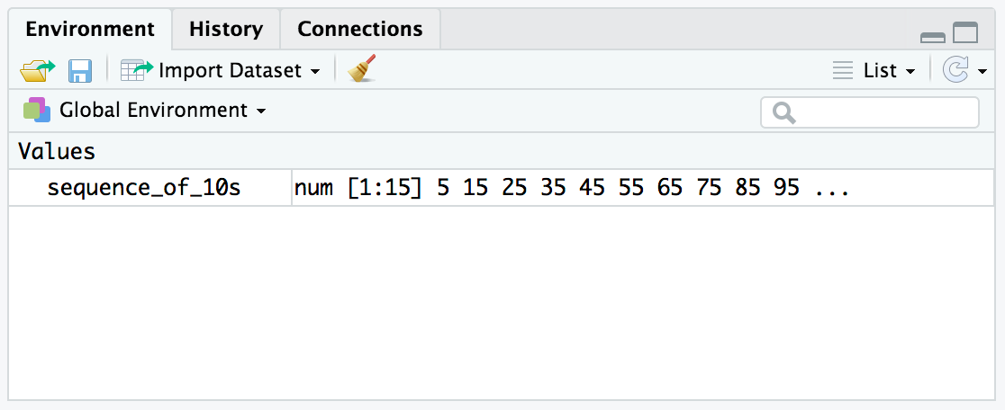
Checking the contents of an object
The environment tab shows us the objects we have created.
Notes:
We can also review our object in RStudio via the environment tab.
When we create an object in the environment, it will appear in the environment tab and we can review its contents there.

Slide 11
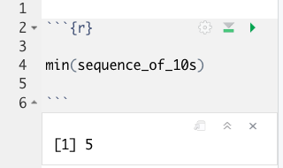
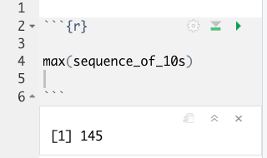
Bending objects to your will
Once we have created an object we can start to interact with it.
This includes passing our objects to other functions… Whoa!
Notes:
Objects are subject to same laws of programming we have learned so far.
We can provides objects as arguments for functions.

Slide 12
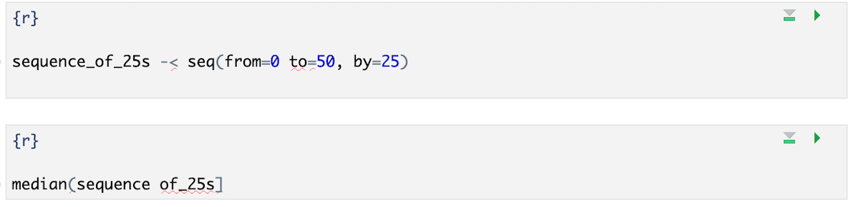
Your Turn #1
I’ve written some code to create a sequence from 0 to 500 in increments of 25 called sequence_of_25s. Ultimately I want to calculate the median value of this sequence. Unfortunately I’ve made some mistakes in my code and I am hoping you can help me find them.
Notes:
We will meet back together in a minute to see if we can fix this code together.
Hint: There are a total of 5 mistakes.

Slide 13
Common functions: combine values into a vector
object
(stores output)
function
(does stuff)
arguments
(input)
short_vector <- c(1, 2, 3, 4, 5)
Create an object called short_vector and store a vector containing 1 through 5
Think of this vector as a column of numbers you can apply functions/perform calculations on

Slide 14
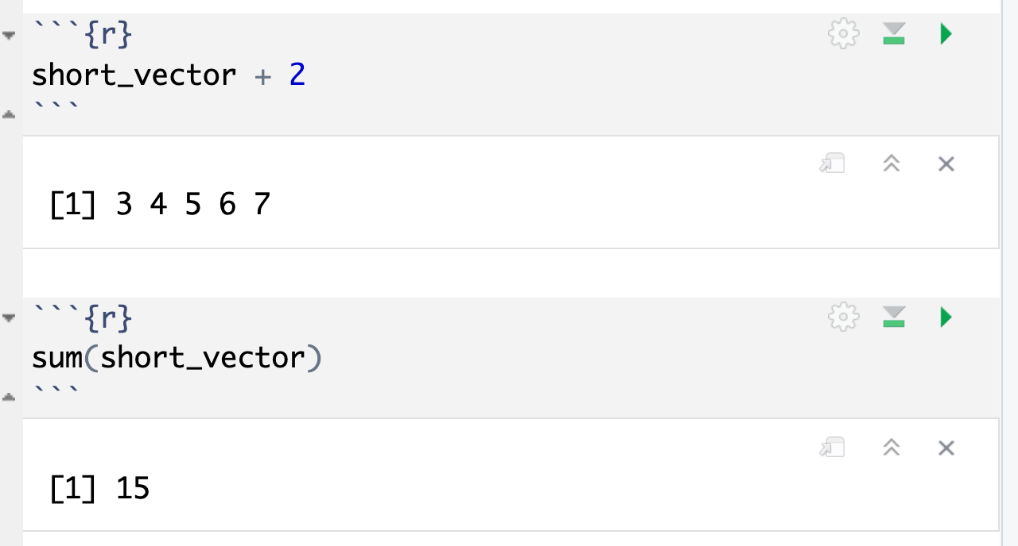
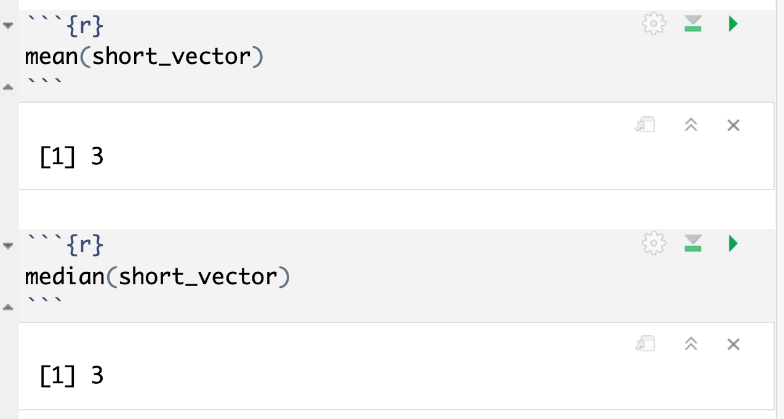
Common functions: simple statistics

Slide 15
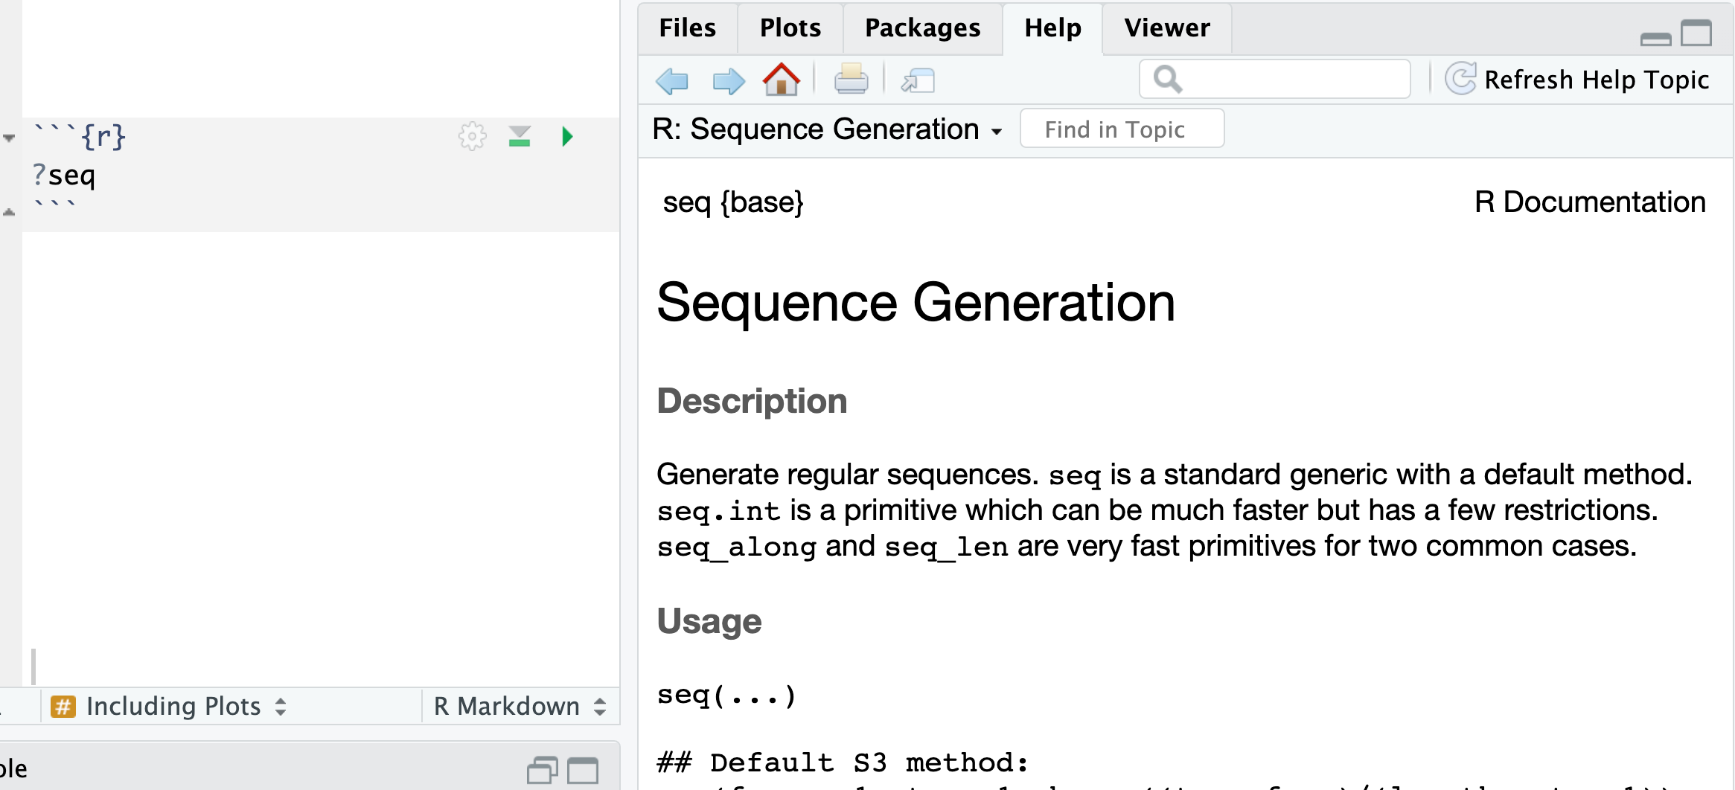
How do I find out more about functions?
Work Aids (RStudio Cheat Sheets: https://www.rstudio.com/resources/cheatsheets/)
A Good Book (R for Data Science: http://r4ds.had.co.nz/)
The Internet (Stack Overflow: https://stackoverflow.com/)
Notes:
Sometimes you will need more help than the R help feature provides.
There are many wonderful freely available resources on the internet to assist you.
Chances are others have tackled similar challenges. A quick internet or forum search can often provide an answer.
The folks at RStudio have developed a number of cheat sheets which are great references. Many of us keep printed copies of these near our desks for the features and tools we use most.
Also, there are a number of great reference books out there. One of our favorites is R for Data Science. It is freely available online and print copies are available also.

Slide 16
Importing Data
Notes:
Now that we are familiar with how to create R Markdown documents we can begin the process of performing data analysis in R in earnest by importing a clinical data set.

Slide 17
The Data Analysis Pipeline
From R for Data Science (https://r4ds.had.co.nz/introduction.html)
Notes:
This diagram may look familiar, you saw it in the Welcome presentation.
The first step in the data analysis pipeline is to load the data into the environment so we can begin to tidy and transform that data.
In today’s course we will be using a de-identified data set consisting of COVID-19 laboratory test results from a microbiology lab. This data is stored as a CSV file.

Slide 18

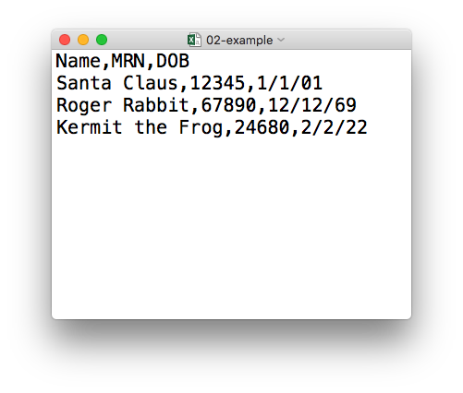
plain text (“flat”) file
csv
rectangular structure
header row
Notes:
So what’s a CSV file? CSV stands for comma-separated values.
** A CSV file is a plain text file, which means you can open it in a text editor and look at it.
Here we have a CSV file with the names, medical record numbers, and dates of birth for three fictional “patients”
** This data structure is called rectangular because it falls into rows and columns, where each row has the same # of columns, and each columns has the same # of rows.
** Also note that this particular CSV file has a header row that instead of data, has a descriptor of what kinds of data are found in each column. CSV files often but not always have such a header row.

Slide 19
Tidyverse: R Packages for Data Science
A consistent way to organize data
Human readable, concise, consistent code
Build pipelines from atomic data analysis steps
Notes:
To import our CSV data, we need some additional data analysis tools. In this course, we will be leveraging the Tidyverse.
The Tidyverse is a modern set of tools for data analysis in R. It’s quickly becoming the de facto standard for doing data science with R.
The basic tenets of “tidy” data analysis include:
Data should be organized in a consistent, standardized way. Each row is an observation, and each column is a variable. This is a very common way to organize data in a spreadsheet and might sound familiar from how you may already organize data in tools like Excel.
Programming code that acts on the data should be consistent, concise, and mimic the narrative language as much as possible.
Each data analysis can be broken down into a series of atomic steps, such as “select this column” or ”arrange the data by the values in that column”. An arbitrarily complex data analysis can be broken down as a pipeline of atomic steps.

Slide 20
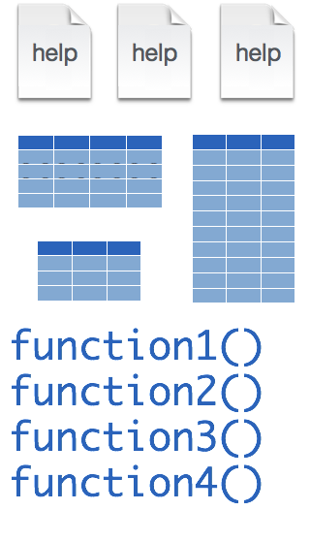
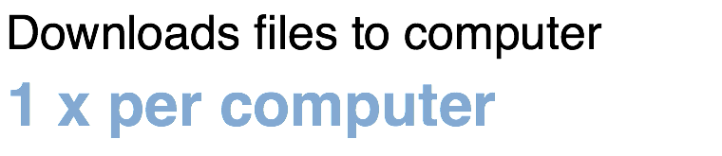
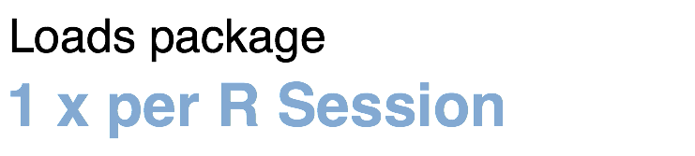
Installing and loading R packages
tidyverse
install.packages("tidyverse")
library(tidyverse)
Note: you will have to reinstall packages when you upgrade to a new version of the R language (not a new version of RStudio, though)
Notes:
The Tidyverse is package (a collection of functions, data, and help documentation) that we can use to extend the functionality of R.
Packages need to be installed explicitly – with the command install.packages. So let’s say you want to install a package named “tidyverse”. You go to the R Console and type install.packages(“tidyverse”).
Each package you want to use needs to be installed only once on each computer. However, in order to use the functions or data in the package, you also need to load the package. This is done with the command “library”. So to enable all the functions in the “tidyverse” package, you type library(“tidyverse”). Packages remain loaded until you quit R. So every time you start a new R session you have to load each package that you want to use again.
On our RStudio Server, you won’t need to install any packages for this course (we have installed them for you). But at times in this course you’ll need to load packages.
So these are the first two R commands we’ve covered - install.packages and library.

Slide 21
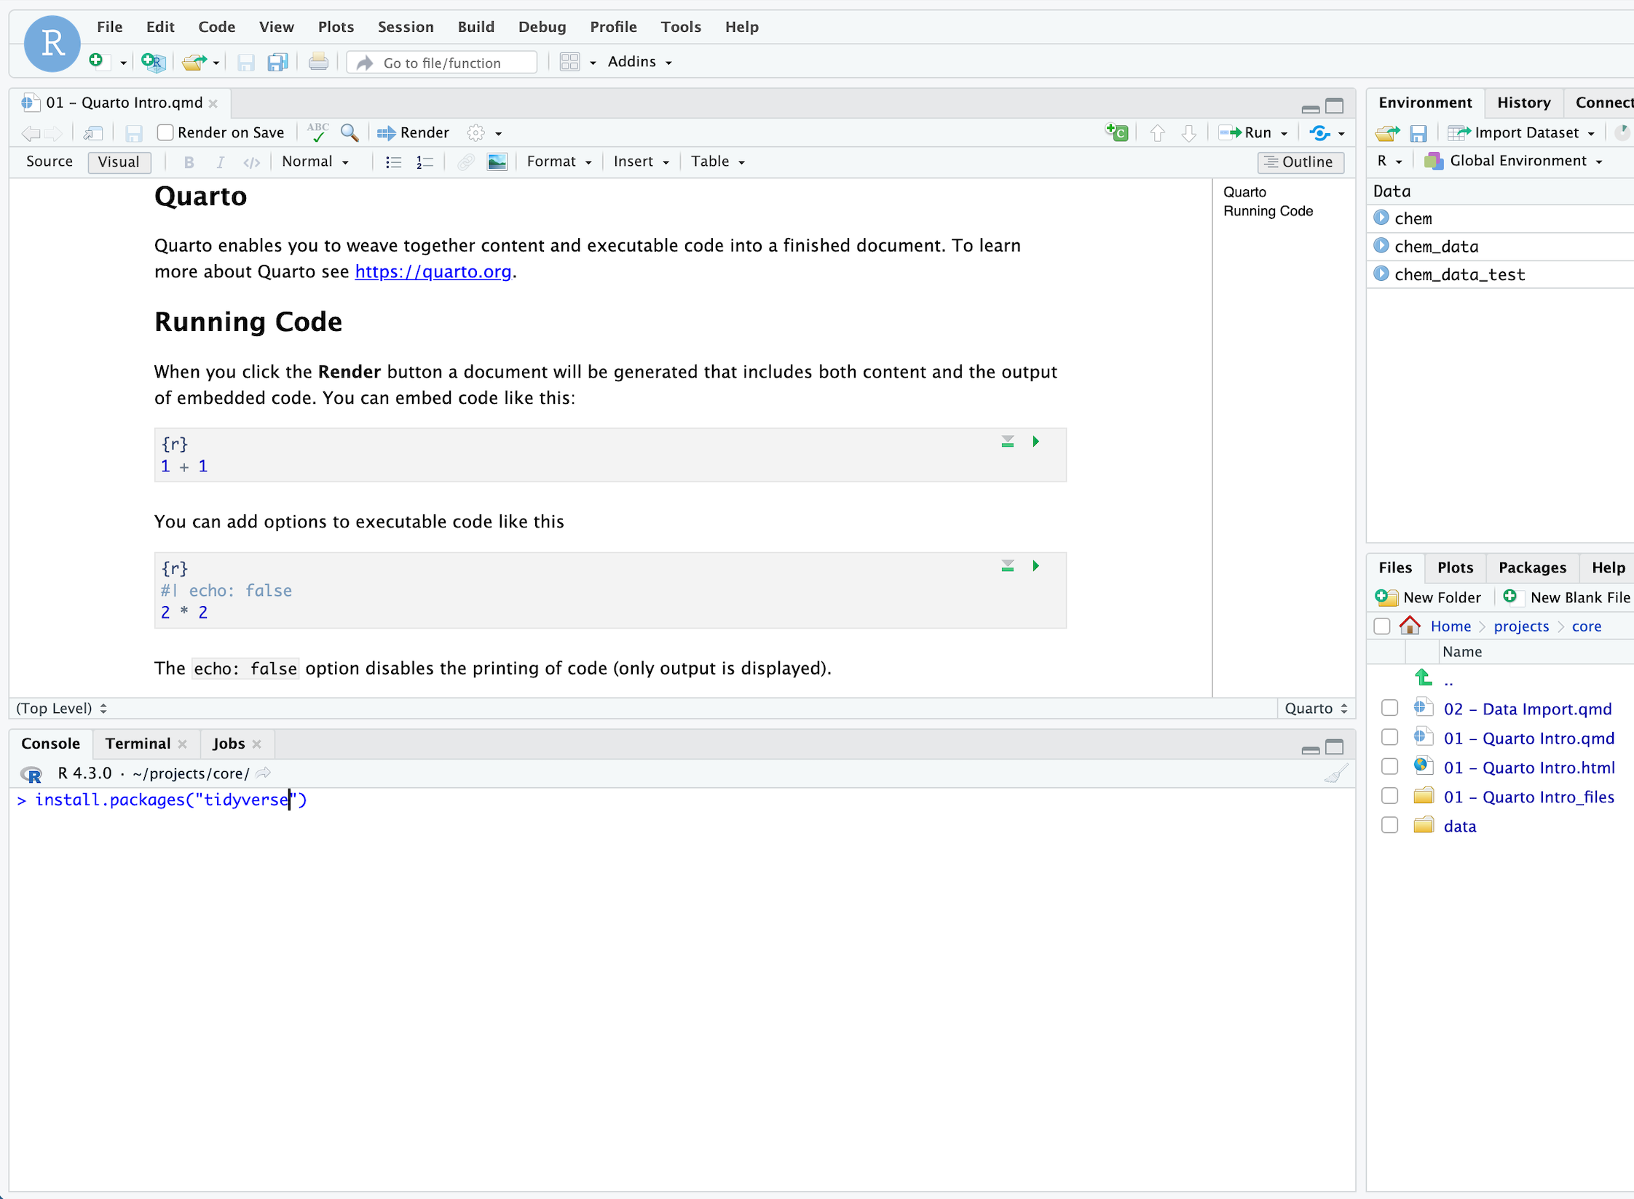
Your Turn #2
Since you are a new user on this server, you will not have any packages beyond the core R language.
Go ahead and install the “tidyverse” package using the install.packages() function in the Console. It will take a few minutes to load. Put up your sticky when you are done

Slide 22
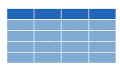

Dataframes: Beyond the Vector
Dataframe is the term for a type of table that aligns with the “tidy data” model
Dataframes are composed of:
Columns (Variables)
Rows (Observations)
Dataframes are objects and can be acted on like other objects
csv
xls
db
Notes:
Dataframe is the term we use for a table (think Excel spreadsheet).
Dataframes consists of columns (variables) and rows (observations). This is the tidy way to organize our data.
We can store dataframes as objects and perform actions on them like other objects.
We can get data into R from a variety of file formats (comma separated value files, excel spreadsheets, or directly from databases). This is the import part of data analysis.

Slide 23

read_csv()
data_frame <- read_csv(file_name)
csv
Notes:
Once, the Tidyverse package has been loaded via library, we can import CSV files using the read_csv() function.
Here is a template for how to use the read_csv function to create a data frame object from a CSV file.
You start with the name of a data frame object then you have this left-ward arrow then read_csv and then the file name in parentheses.

Slide 24
function
(does stuff)
data_frame <- read_csv(file_name)
Notes:
This code construct is exceedingly common in R, so I want to spend a few minutes exploring it together
Previously we talked about the absolute value and sequence functions.
read_csv() is also a function. Remember that functions are defined in packages. We loaded the Tidyverse package to be able to use the read_csv function.
You may be familiar with functions from math class. A function takes an input, say an ‘x’ value and returns an output, say a ’y’ value. Functions in computer programming also take inputs and return outputs. But the inputs and outputs here are the arguments and objects that exist within the context of a programming language.
For read_csv, the input is the file name of a CSV file; and the output is a data frame with the contents of the file.

Slide 25
function
(does stuff)
argument
(input)
data_frame <- read_csv(file_name)
Notes:
The input that goes into a function is called an argument. The argument to a function gets put in parentheses.
A function can have zero, one, or many arguments. If there is more than one argument, we use commas to separate them (remember the multiple arguments of the sequence function). We’ll see additional examples of this later.

Slide 26
object
(stores output)
function
(does stuff)
argument
(input)
data_frame <- read_csv(file_name)
Notes:
- The read_csv function outputs a data frame (think table), but if we want to *capture* that data frame inside of a named object, we need to specify that explicitly. It is a great idea to capture the output of a function in an object so it can be used as the input for other functions, for example to summarize or visualize the data in the named object.

Slide 27
object
(stores output)
function
(does stuff)
argument
(input)
data_frame <- read_csv(file_name)
assignment operator
(“gets”)
Notes:
To put the output of the read_csv function into a named object, we use the assignment operator.
The assignment operator is a smaller-than followed by a dash or minus and looks kind of like an arrow pointing left. It’s usually read as “gets.”

Slide 28
read_csv()
data frame to read data into
name of
CSV file
chem <- read_csv(”chem_data.csv")
chem
chem_data.csv
csv
Notes:
Let’s put these pieces together to load our covid data set.
This line of code reads the “covid_testing object gets the output of the read_csv function on the covid_testing CSV file”.
You might notice that one of the objects is put in quotes and the other one isn't.
To be honest, quotes can be confusing. Names of objects such as data frames don't get quotes. In contrast, literal file names are always put in quotes. This is part of the grammar of coding (the syntax) in R that will become more familiar to you as you develop proficiency and comfort with the language.

Slide 29
Your Turn #3
In the pre-course instructions I provided a chem_data.csv file we will work with: find that file on your local computer
In your core folder (viewable in the Files window of RStudio) add a data folder and navigate there
Using the Upload button in RStudio, import the chem_data.csv file into the data folder
Put up your sticky when you are done

Slide 30
Best Practice: Data Analysis Should be Separated from Raw Data
No matter how you choose to analyze your data you should always create a new file for your analysis
Why?
Traceability: it is more difficult to identify mistakes in an analysis if you can’t look back at what you originally received
Mistakes: if you overwrite an important cell or field you may not be able to identify the mistake and may not be able to fix it without re-requesting the data

Slide 31
How do you separate your analysis from raw data?
In Excel: use “Save As…” immediately after you receive your data
In R or other programming languages, reading a file in generally does not change the original file
This can help enforce good practices
If you need to create an output file, you can use a write to file function (later this lesson)
Name your output/analysis file with a name that you’ll be able to recognize a year from now

Slide 32
Best Practice: Always Inspect your Raw Data
Before diving into a data analysis, lay eyes on the data set
Can open the file in Excel
Programming language development environment may also allow you to look at the raw data – e.g. Rstudio
Understand the meaning of rows and columns: tidy data

Slide 33
Your Turn #4
In your pre-course instructions the course website was shared with instructions to download the material. Access that material (you may need to unzip the download) and Upload the numbered .qmd files into your core folder.
Open the Quarto file:
“02 – Data Import.qmd”
In the Editor pane, follow the instructions to complete the exercise. Stop when you see “Stop Here” and put up your sticky to signal that you are done.
Notes:
One final your turn in this session.
In this exercise, we will ask you to open an R Markdown document and follow the instructions contained in that document to load and explore our data set.
We will meet back in 5 minutes to go over this exercise together.

Slide 34
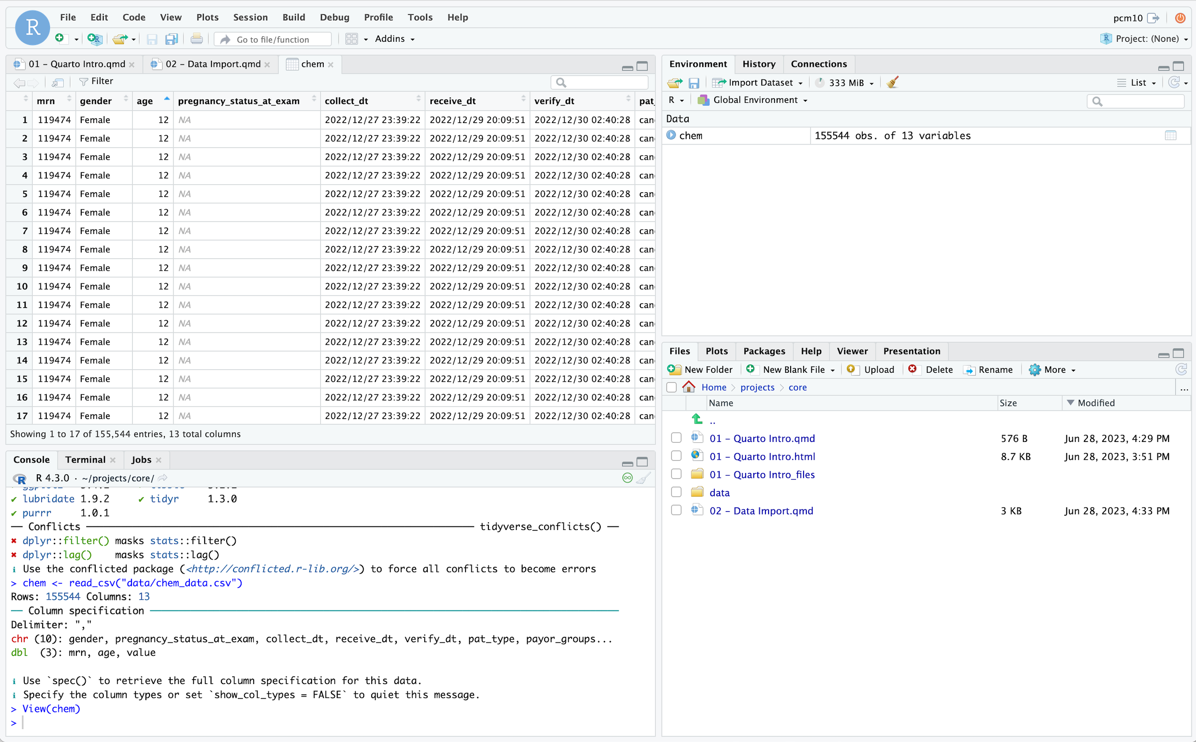
Can sort by clicking on variable
Click on object in Environment
Can open up viewer from console

Slide 35
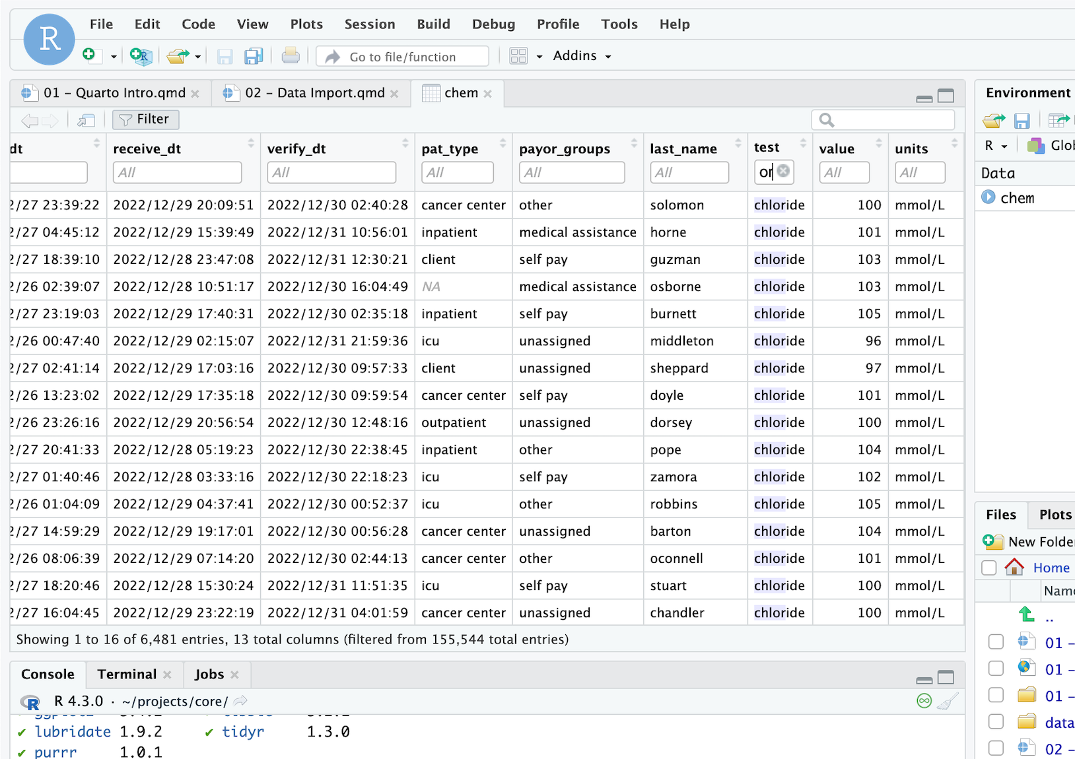
Filter can search variables
Shows rows meeting criteria

Slide 36
Best Practice: Always Inspect your Raw Data
Inspect for any missing data
How is missing data represented? Blanks, NULLs (SQL), NAs (R), -1?
Programming languages provide functions that perform a summary of the data set
If applicable, sort data column by column
Most helpful if each column = specific field or data element
Helpful to see the “lowest” and “highest” values by column
Can identify unexpected data types

Slide 37
Data Types

Slide 38
Computers Think about Data Differently
Regardless of the tool you use to analyze data (e.g. Excel vs. R), the tool will categorize your data into data types
Data types dictate the computer’s ”rules” for acting on your data
Common data types:
Character
Number (could be integer vs. numeric with higher precision)
Logical (TRUE vs. FALSE)

Slide 39
Some special data types are linked to specific behavior
Dates, times, or datetimes are common in lab data sets
Special rules required to sort these types: AM vs. PM, parsing hours, minutes, seconds
Categorical data, or factors in R, may have a special representation to enable quicker summaries/calculations
Normal, STAT, and Timed may be more appropriate to represent as a categorical variable than a character
Categorial representation may be more efficient to count and display as different variables on a plot

Slide 40
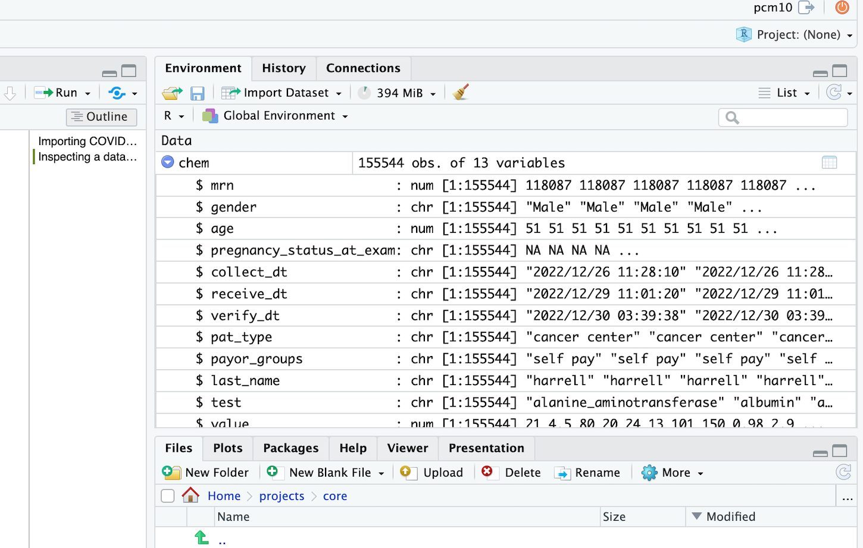
Display and calculation behavior depends on the data type of a variable
Common data types:
num = numeric (there are subtypes based on precision, i.e. decimals)
chr = character
Factor = categorical variable (i.e. M, F, U)
POSIXct = date & time format
Logical = TRUE or FALSE
Press button to see details

Slide 41
Which variables should be converted to a different data type?
Common data types:
num = numeric (there are subtypes based on precision, i.e. decimals)
chr = character
Factor = categorical variable (i.e. M, F, U)
POSIXct = date & time format
Logical = TRUE or FALSE

Slide 42
Your Turn #4
Pick up where you left off in “02 – Data Import.qmd” and work through the Modifying Data Types section.
In the Editor pane, follow the instructions to complete the exercise. Stop when you see “Stop Here” and put up your sticky to signal that you are done.
Notes:
One final your turn in this session.
In this exercise, we will ask you to open an R Markdown document and follow the instructions contained in that document to load and explore our data set.
We will meet back in 5 minutes to go over this exercise together.

Slide 43
Exporting Data
Notes:
Now that we are familiar with how to create R Markdown documents we can begin the process of performing data analysis in R in earnest by importing a clinical data set.

Slide 44
Write data to files
name of
CSV file to write to
data frame to write file from
write_csv(data_frame, “file_name.csv”)
data_frame
file_name.csv
csv
Notes:
Let’s put these pieces together to load our covid data set.
This line of code reads the “covid_testing object gets the output of the read_csv function on the covid_testing CSV file”.
You might notice that one of the objects is put in quotes and the other one isn't.
To be honest, quotes can be confusing. Names of objects such as data frames don't get quotes. In contrast, literal file names are always put in quotes. This is part of the grammar of coding (the syntax) in R that will become more familiar to you as you develop proficiency and comfort with the language.

Slide 45
Your Turn #5
Pick up where you left off in “02 – Data Import.qmd” and work through the Exporting Data section.
In the Editor pane, follow the instructions to complete the exercise. Stop when you see “Stop Here” and put up your sticky to signal that you are done.
Notes:
One final your turn in this session.
In this exercise, we will ask you to open an R Markdown document and follow the instructions contained in that document to load and explore our data set.
We will meet back in 5 minutes to go over this exercise together.

Slide 46
Separating your analysis from raw data
In Excel: use “Save As…” immediately after you receive your data
In R or other programming languages, reading a file in generally does not change the original file
This can help enforce good practices
If you need to create an output file, you can use a write to file function
Name your output/analysis file with a name that you’ll be able to recognize a year from now

Slide 47
Should you save intermediate versions of your analysis?
There is always a risk you will make a mistake in an analysis and want to backtrack
For analysis in Excel, consider a couple strategies:
Save intermediate analysis files with dates to track
Use OneDrive – you can save the same file and revert to a previous version
Analysis with a programming language emphasizes saving a script rather than a data file – you can re-execute the script if needed
May still want to use OneDrive or a version control system (e.g. git) for your script

Slide 48
Recap
Functions do stuff. They accept Arguments to define parameters. We can store the output of functions in Objects using the assignment operator ( <- ).
Packages extend the functionality of R. They need to be installed once per computer and loaded each session.
Importing Data is the first step data analysis pipeline. read_csv() is a function from the tidyverse that we can use for importing data.
Notes:
To recap what we have covered in this introductory lesson.
We started by defining and differentiating R (the programming language) from Rstudio (the development environment) from R Markdown (the document format we use for reproducible data analysis).
In addition to learning to create and edit R Markdown documents we discussed some basic coding vocabulary including:
-Packages (such as the Tidyverse) which extend the functionality of R. We us the install.packages() function to install packages, and the library() function to load them into the environment.
-Functions do stuff on our behalf, they accept arguments, and we can store their output in named objects using the assignment operator
-Finally we discussed and practiced importing data using the read_csv() function from the tidyverse, and explored this data visually

Slide 49
What else?
Notes:
At the end of each lesson we have included a what else section to introduce you to ”what else” you may want to explore and learn about after completing this course.
This includes helpful hints, other functions in the Tidyverse, and exciting packages you may want to check out.

Slide 50
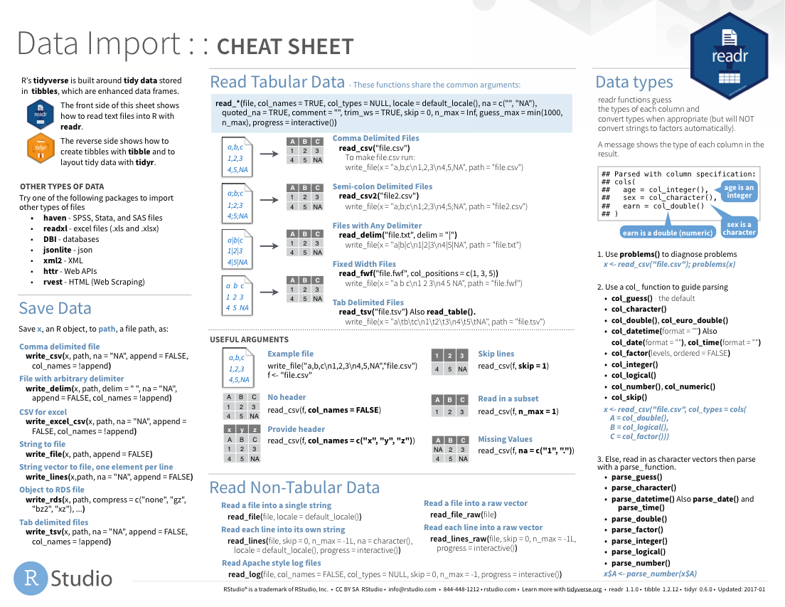
Notes:
The Data Import cheat sheet helps with the grammar of importing data including other file types and those with other separators (like pipes “|” instead of commas).
The Data Import cheat sheet is available on the RStudio website.

Slide 51
Notes:
There are a variety of other packages out there designed to deal with different file formats:
Readxl: Excel
Haven: SPSS, Stat, SAS files
Googlesheets
Rvest: scrape the web
Jsonlite: JSON data and APIs on the web

Slide 52
Reading Excel files
Load package
library(readxl)
data frame to read data into
name of
CSV file
data_frame <- read_excel(”file_name.xlsx")
data_frame
file_name.xlsx
xlsx
Notes:
Let’s put these pieces together to load our covid data set.
This line of code reads the “covid_testing object gets the output of the read_csv function on the covid_testing CSV file”.
You might notice that one of the objects is put in quotes and the other one isn't.
To be honest, quotes can be confusing. Names of objects such as data frames don't get quotes. In contrast, literal file names are always put in quotes. This is part of the grammar of coding (the syntax) in R that will become more familiar to you as you develop proficiency and comfort with the language.

Slide 53
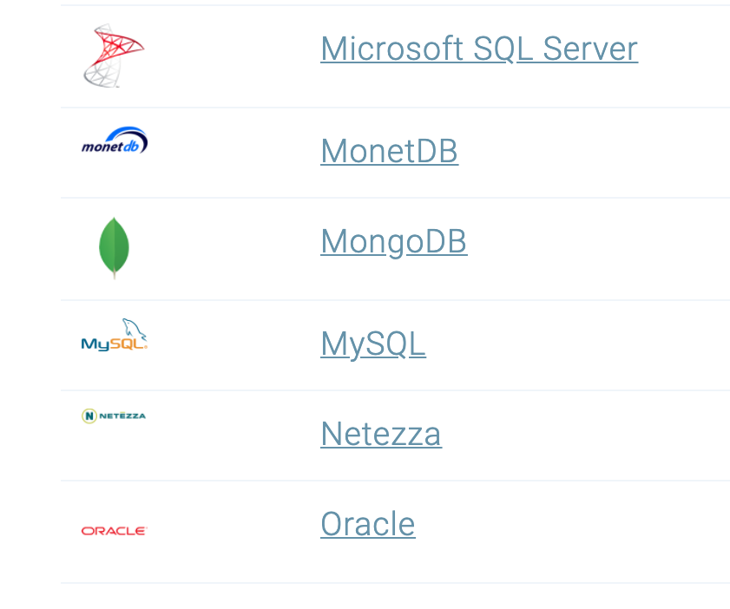
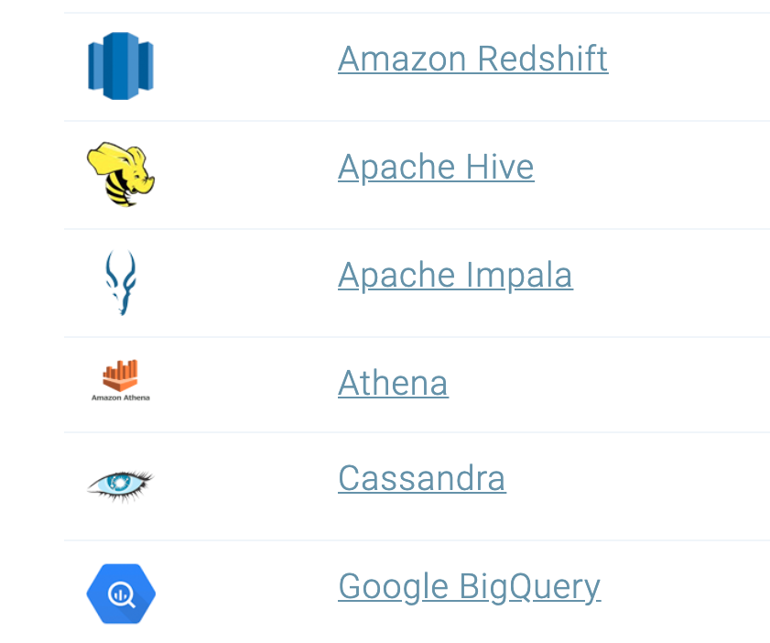
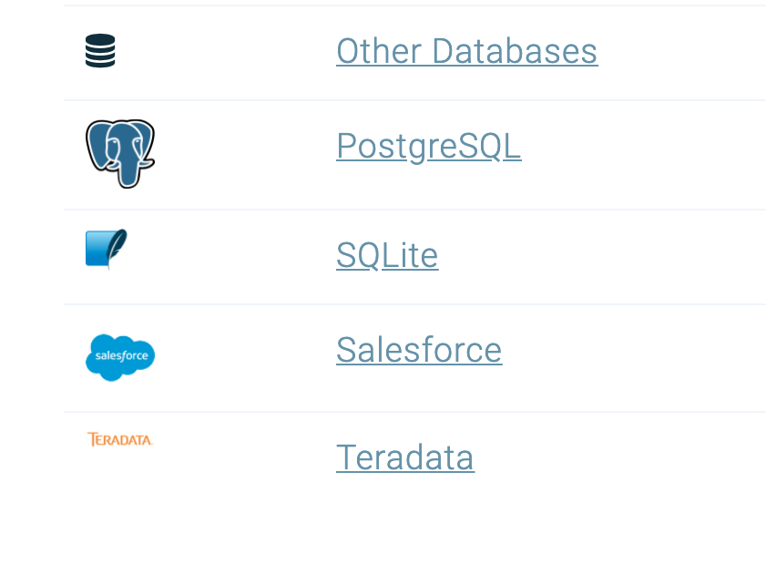
Databases
https://db.rstudio.com/databases/
Notes:
You can also connect to a variety of different databases directly in R to source your data.
If you use any of these, you may want to check out the tools to make database connections in R.

Slide 54
Lesson Goals
Compare and contrast different data types (e.g., numerical, categorical, timestamp, logical) used in data analytics
Conduct basic exploratory data analysis to evaluate data quality or assumptions and summarize using quantitative, qualitative, univariate, and multivariate methods
Lesson Objectives
Use a function to perform an operation on data
Define and create objects in the environment
Install and load packages
Import data from a file into the R environment
Inspect the contents of a dataframe
Notes:
In the second session we will learn some fundamentals of coding including using functions, creating objects, and importing data.

